Slide 1
Psychological Contract and Employee Value Proposition

Slide 2
Psychological Contract : Definition
“Psychological contract is an implicit contract between an individual and his [her] organization which specifies what each expects to give and receive from each other in their relationship” (Kotter, p.no., 92).
“Individual belief in mutual obligations between that person and another party, such as an employer” (Rousseau, 1989).

Slide 3
ACCENTURE SURVEY
“Presented below in the order of importance are the expectations of
candidates with regards to prospective employers:
~ Compensation/ salary (82 percent)
~ Interesting and challenging work (77 percent)
~ The opportunity to gain global experience (63 percent)
~ Prestigious company name (59 percent)
~ Formal training (55 percent)
~ Flexible work hours (54 percent)
~ The company's reputation as an employer (52 percent)
~ Social atmosphere (50 percent)
~ Benefits such as health insurance (42 percent)
~ The supervisor who will mentor and coach (35 percent)
~ Opportunity to travel (34 percent)”
Source : http://www.rediff.com/getahead/2008/jun/03grad.htm

Slide 4
Key components of PC (Employee’s perspective)
Employee expectations will constitute of following dimensions:
Organizational factors (brand)
Reputation- Values (e.g., Ethical), Strong performance, Credible Leadership, Inspiring mission, Employer image (e.g., Fair, developmental), responsible corporate citizen (environment, CSR).
Cultural (e.g., Egalitarian, meritocracy, bureaucratic, entrepreneurial)
Job Factors (products)
Work/ task- Challenging, standard, multiskilled, autonomy, team work, Feedback, working conditions - resources.
Social ties- peer group, supervisor relation.
Lifestyle- part time, work- life balance, travel
Career related factors (products)
Fulfills career expectations (individual career anchors of perceived talent, motives, needs, and values)
Growth and learning opportunities
Transition jobs, part time, contract
Economic (Product)
Short - long term, fixed – variable, Skill-performance – seniority, internal- external equity compensation and benefits.

Slide 5
Employee Value Proposition (EVP)
Employee→ Employer | Standard | Cadre/Group | Idiosyncratic
Organization | Values, culture, responsible corp citizen, mission, strategy | Sub cultures | CSR initiatives, Entrepreneurship
Job/ Career/Economic | Empowerment for all, PRP for all, process orientation, job security, Induction process | Internal Labor mkt for managers, transitory careers for frontline , PRP for managers, unions negotiated wages for workers, OJT | Job sculpting, HI Pos, Fast track careers, Partnership, Training and development, specialist, generalist career tracks, skill based pay, Work life balance
Manager/Supervisor/Peer | Visionary, transformational leadership | Team work, Talented peers, functional excellence. | Good working relation, Coaching and Feedback, Mentoring, voice

Slide 6
Individual segmentation - dimensions
Age- Gen X, Gen Y.
Life/Career Stage- Fresher, Early days, Middle career, Senior years.
Level - Fresher, Junior, Middle Mngt., Senior.
Education – Tech/ Non tech, graduate, PG
Gender
Economic strata
Employment Relation– Part time, contract, permanent
Function – R&D, Sales, Production.

Slide 7
Mapping employee expectations to segments - Framework
PC Dimension-> Demographic | Organization | Job/ Career | Economic
Age/ Exp – Gen Y
Education- Phd Level- Entry level
Life/ career stage - Young single
Gender - Female
Economic strata - Poor family
Employment relation- Full time
Function – R&D

Slide 8
Mapping employee expectations to segments - Process
Interview and profile high performers on the job.
Focused group discussions with segments of employees, e.g. MBA graduates.
Exit Interviews, PA feedback sessions and forms, Recruitment selection data.

Slide 9
Business Context- PC or EVP (Employer perspective)
External context
Economy, Industry, Regulations, National Culture, Political environment
Internal context
Strategy, size, structure, life cycle, leadership, technology.

Slide 10
Analytical Framework
Promises, obligations, & inducements
Standard/ Org
Attitudinal outcomes
Business Context
-Internal
HR Policies & Practices
Group/ cadre
Delivery of deal: Met expectations
Business Context
-External
Idiosyncratic/
employee
Behavioral Outcomes
Targeted employee segment
Expectations

Slide 11
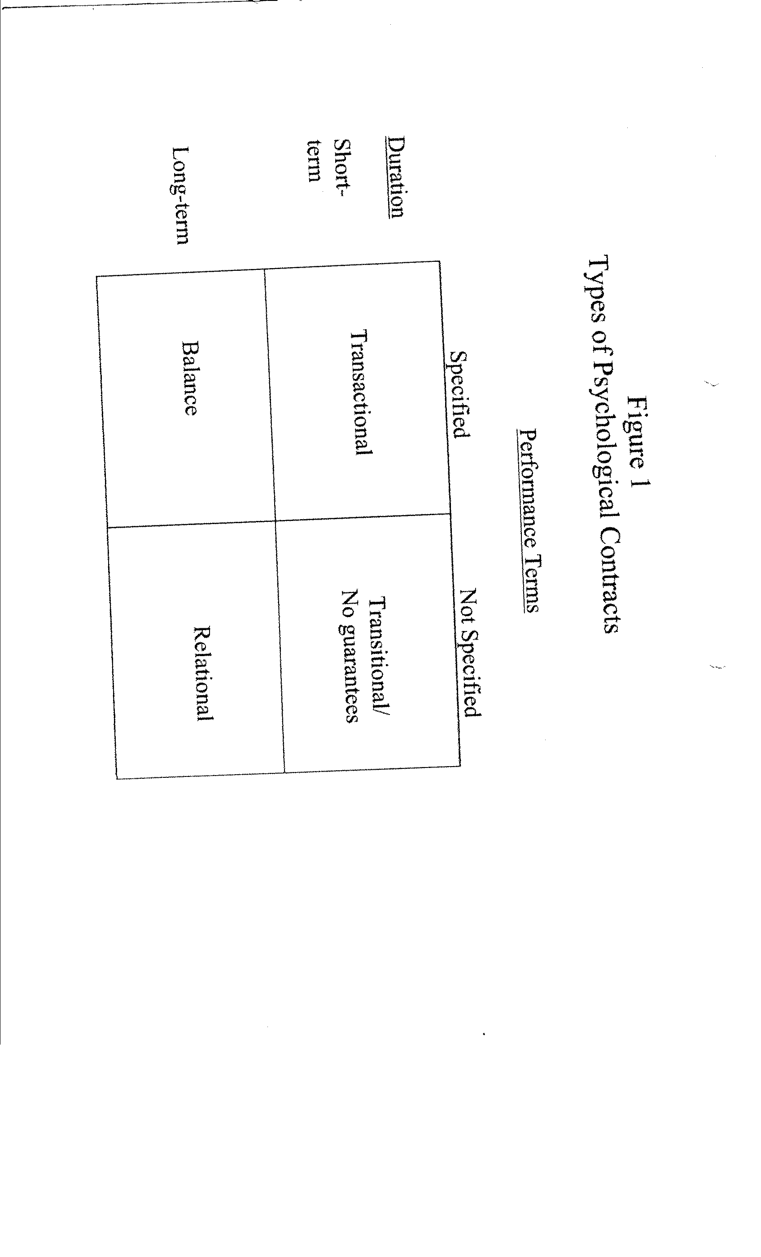
Psychological Contract : Standard Types
Ref: D.M Roussaeu (2000). Psychological Contract Inventory Technical Report. CMU.

Slide 12
Psychological Contract : Standard Types
Transactional
Low ambiguity, easy exit/ easy turnover, low member commitment, freedom to enter new contracts.
Relational
High member commitment, High affective commitment, High integration, stability.
Balanced
High member commitment, High integration, ongoing development, mutual support, dynamic.
Transitional
Ambiguity/ Uncertainty, High turnover/ termination, instability

Slide 13
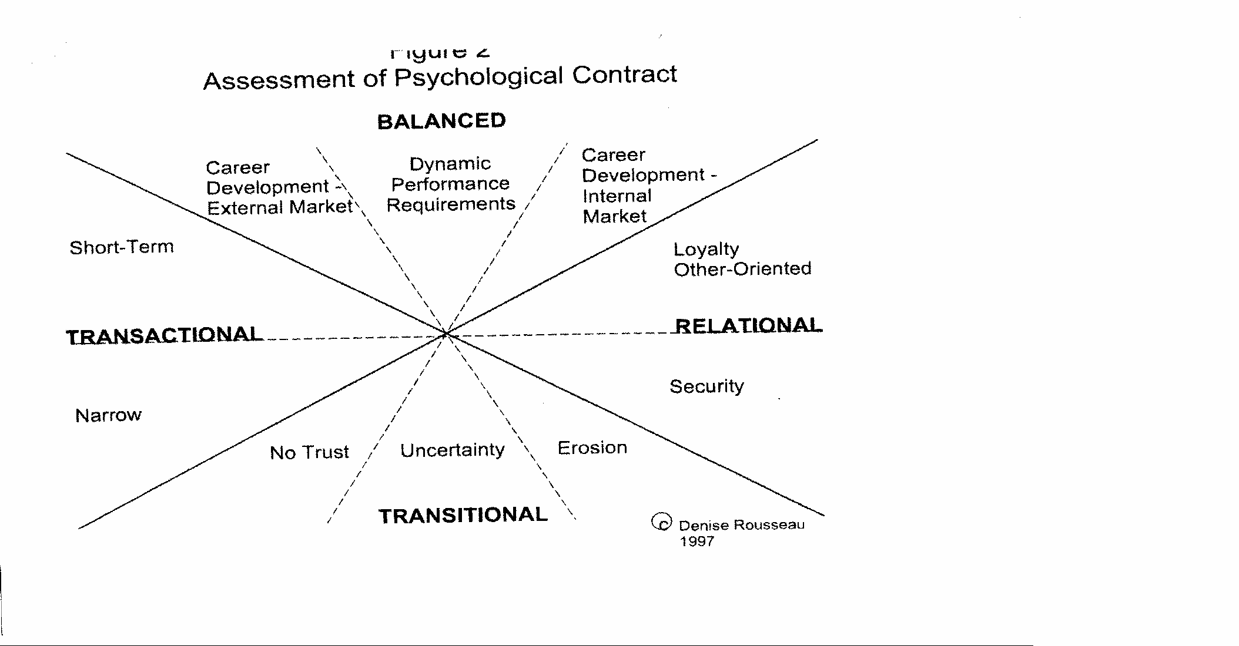
Psychological Contract: Standard types
Ref: D.M Roussaeu (2000). Psychological Contract Inventory Technical Report. CMU.

Slide 14
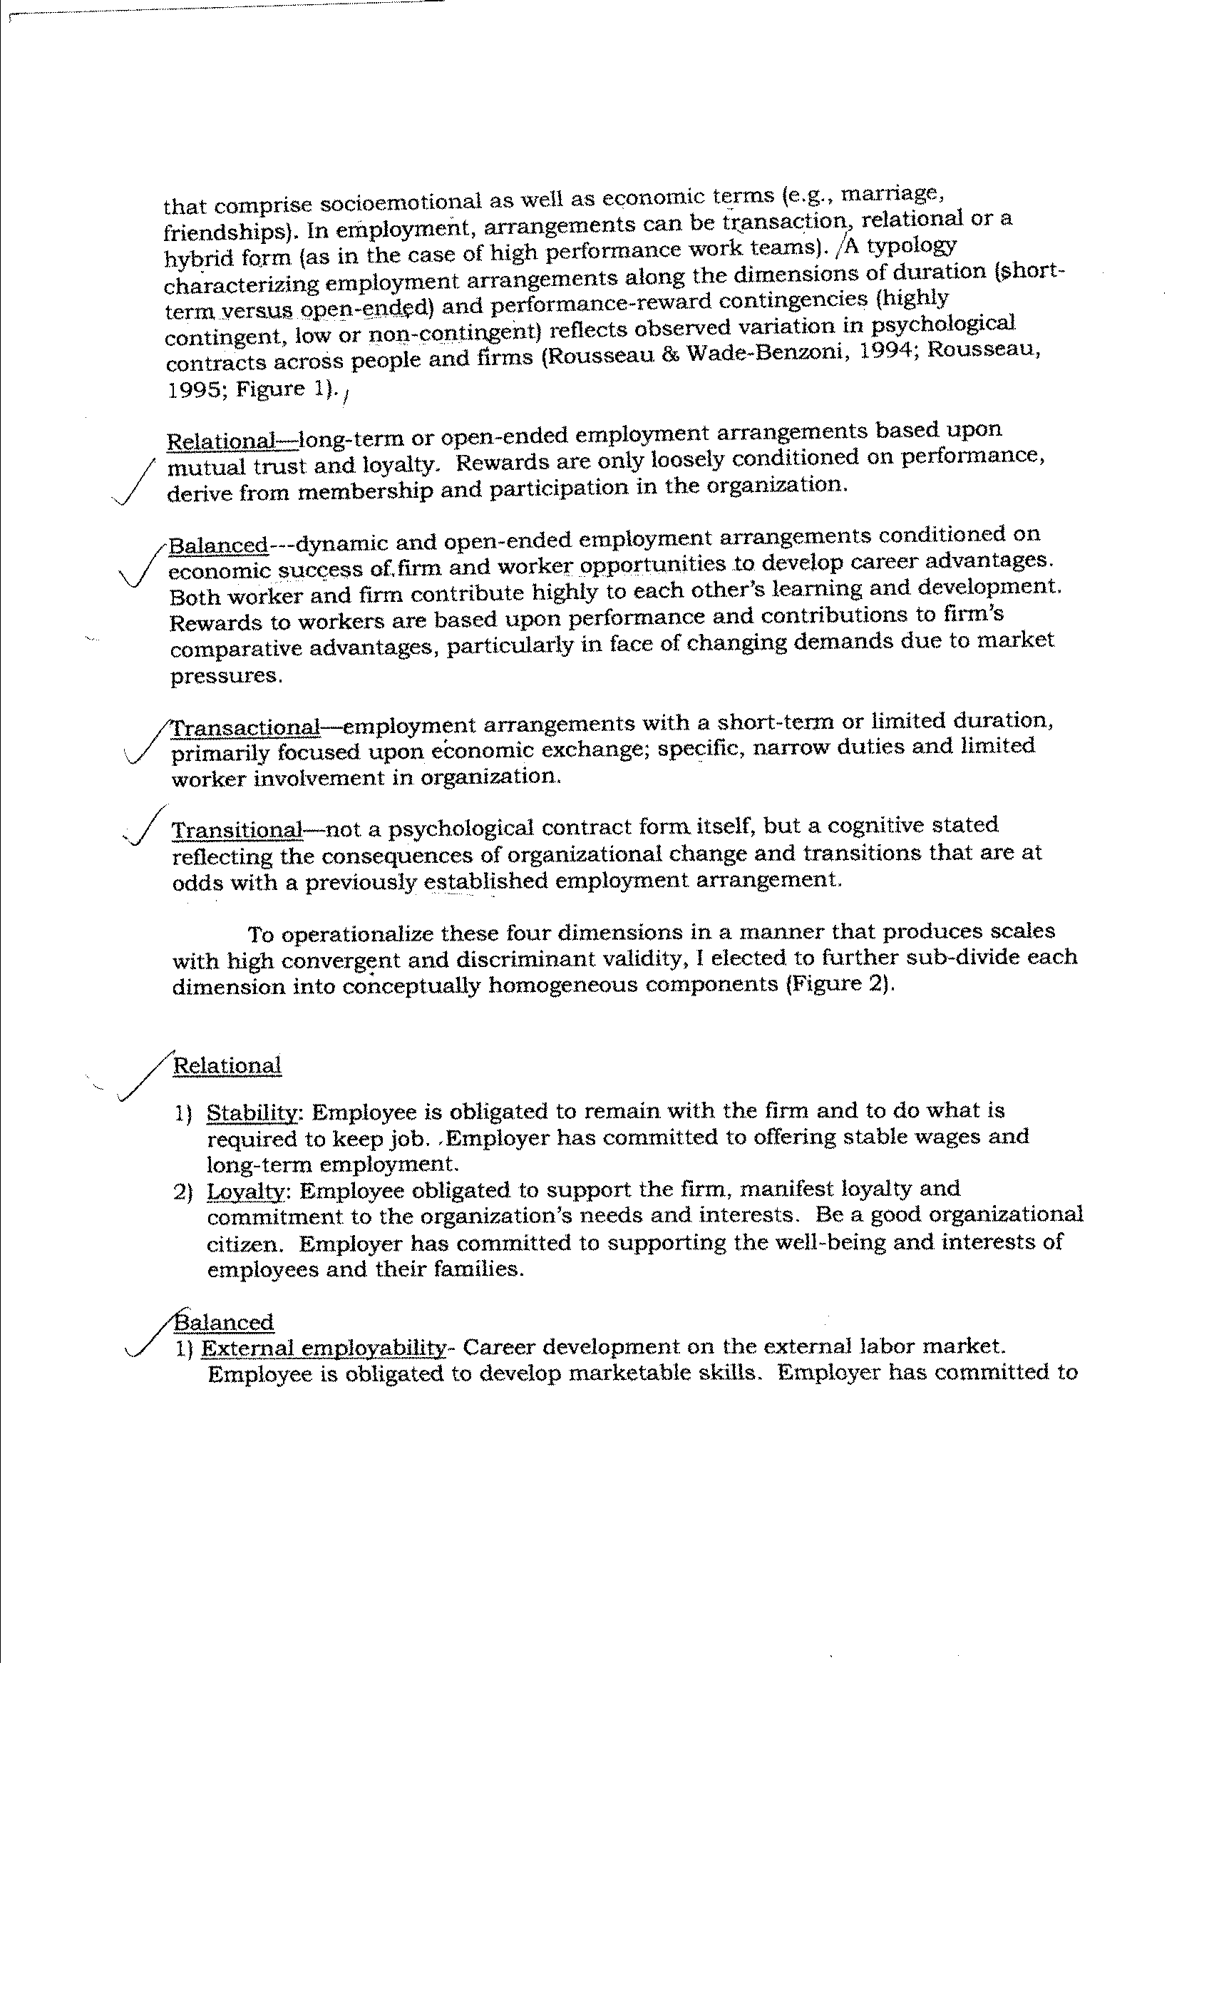

Slide 15
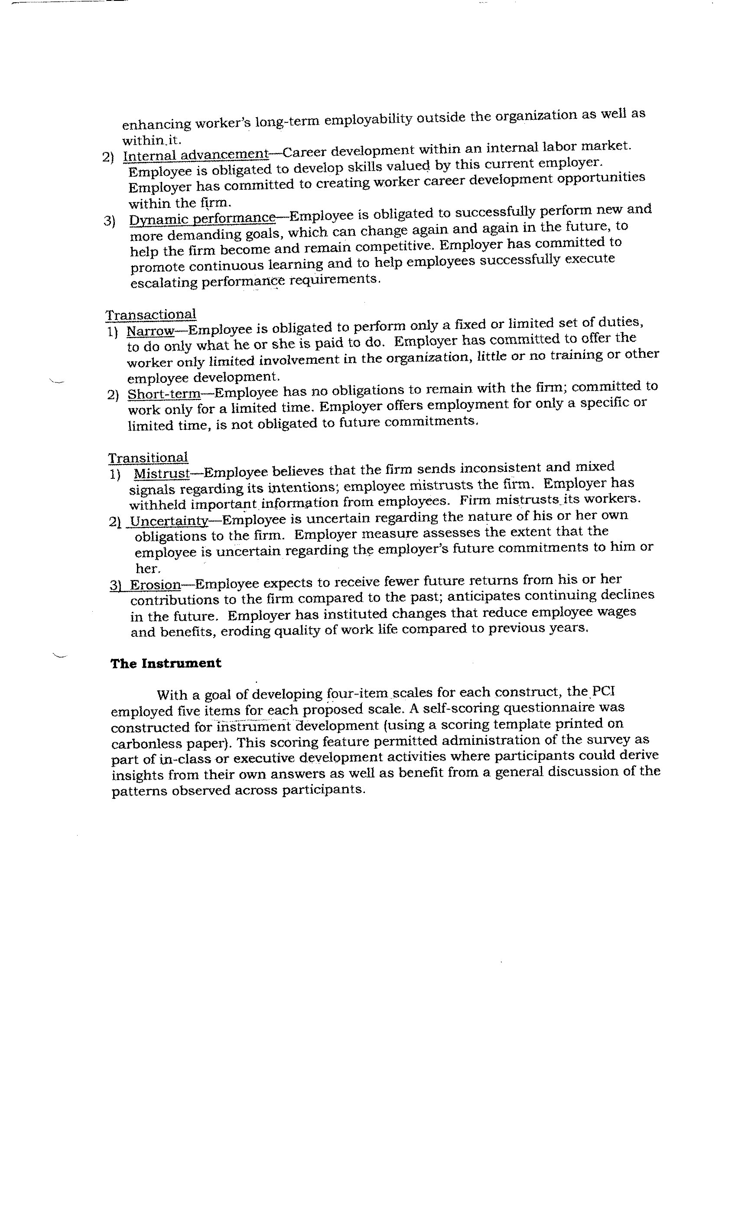

Slide 16
Business Strategy and HRM System
Miles and Snow Typology of Strategic Choice | Defender | Prospector
Work Flow | Efficient production, control emphasis, job descriptions, detailed work planning | Innovation, Flexibility, broad job classes, Loose work planning
Preferred Business Strategy (Porter ‘s Typology) | Cost Leadership | Differentiation
Career Path | Internal Labor Market Internal Succession Planning | External Labor Market External Supply Chain management
Basic HRM Strategy | Build | Acquire
Psychological Contract | Relational Organizational Commitment | Transactional Professional Commitment
Organizational Culture | Strong | Weak
Structure | More likely to be Hierarchical | Comparatively flatter with more empowerment downwards
Jobs | More structured, standard with clear authorizations and responsibility | More autonomy, broader job descreptions.
Recruitment/Selection | Entry level, P-O fit very critical, cultural fit critical, Internal | All Levels, P-J fit very critical, technical/ functional skill critical, External
Training & Development | Skill Building, Leadership dev, functional expertise , Firm Specific Training | Skill Acquisition, very selective training inputs for critical resources, General
PMS | Developmental Focused Behavior/Process oriented | Control Oriented, Reward focused Outcome Based
Compensation | Job / Seniority based Internal Equity | Performance Based External Equity
Attrition | Very Low, Slightly Higher at entry | Comparatively Higher

Slide 17
Survey Results : Psycho Contract Indian Railways Prob. officers
Dimension | Org. Obligation (Employee expectations) | Mean score | Employee obligations | Mean score
Relational | A3 : Personal welfare (Loyalty inducing) | 3.74 | B3:Loyalty | 3.88
 | A7: Job/ financial security | 4.30 | B7:Long term plan with organization | 3.54
Transactional | A2: Short term employment | 2.07 | B2:Short term plans | 2.47
 | A4: Narrow focused job | 2.94 | B4: Narrowly focused perf. commitment | 2.66
Balanced | A1: Internal development opportunities | 4.22 | B1:Proactivley developing for org utility | 4.22
 | A5: Support for high performance | 3.71 | B5:High performance orientation | 3.99
 | A6: Externally marketable skills development opp. | 3.54 | B6: Develop my external marketability | 3.21

Slide 18
Some more Examples
A silicon valley semiconductor major, Cypress, in its early days focused on niche markets where big players INTEL and AMD would have n’t ventured because of small volumes. Its success depended on churning new products. It adopted a federal structure where employees with new ideas could open their own product companies within Cypress federal fold, have their own board, and P&L statements. HQ acted like a venture capitalist and set profitability targets for small units. If targets are achieved HQ will reduce its stake in unit otherwise increase stake thus increasing the share of entrepreneur and their incentive. The units also acted like a quasi market where product companies could give contract for manufacturing these products t o manufacturing companies again within Cypress fold on competitive basis. Even support function ;like HR had to compete with outside vendor if could n’t provide value for money to internal customers like product cos. Many of the employees were Phds. Organization was great success and had 3500 product lines at one time. The org offered great EVP and fulfilled the PC of its key segment. How?

Slide 19
Another Example
CIRCA 2008: Aravind Eye Care was started by Dr V at the age of 60 with mission “Eradicate Needless Blindness from Tamil Nadu”. Dr V and others were passionate about the Vision had Influence of Mahatma and Aurobindo, “Give than Take” Credo; inculcated spirituality at work place; and followed Leading by Example and Doing. The culture was “Service” with Humility, Kindness, & Equality; Egalitarian, Mutual Respect; Transparent. Administration by Doctors. Financing of operation and expansion mainly thru’ Internally Generated Surpluses; No debt financing to maintain control and freedom ; Some Donations, Govt, and world bank aid. Highly standardized operation- avg. time 12 minutes; Doctors operates 16-20 patients in half day for 6 days.
Valued Professional Doctors ready and motivated to work at high pace 95 times more productive than Indian average) in standardized fashion on a single specialty (63% cases Cataract) for 6 days (1/2 day). Spend their Sundays at Camps. Driven by mission. Dedicated highly trained Ophthalmic Assistants, nursing aides, Counselors taking extra responsibilities to free up time of Doctors. Low attrition rates for paramedics justifying the high training costs. Doctor’s time divided as (60% clinical, 20% teaching, 20% research). However doctor’s attrition is increasing and becoming a concern? Why? Is their some mismatch in PC happening?

